Slide 1

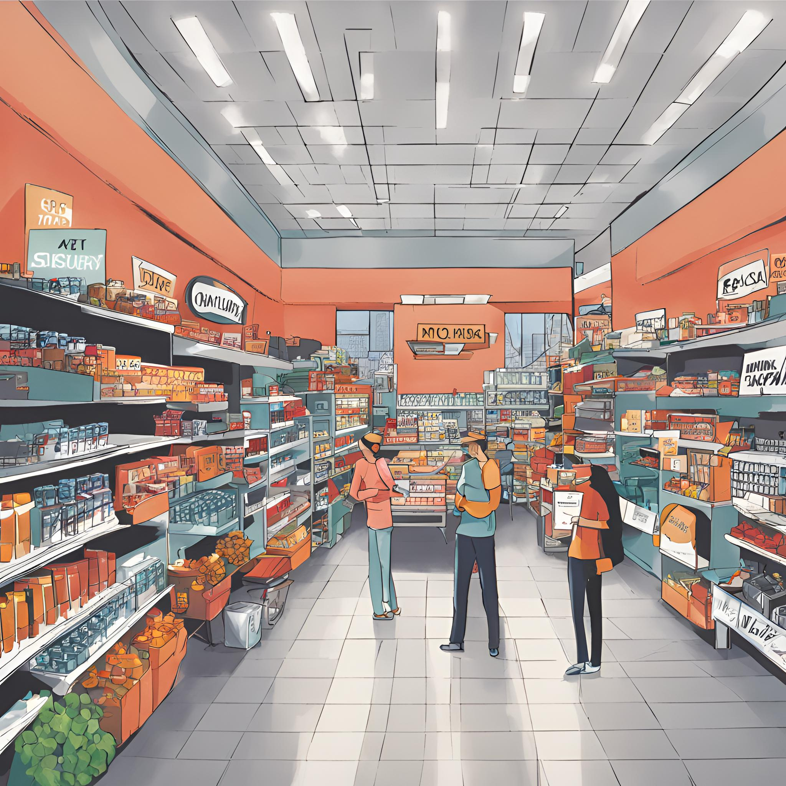
project
RETAIL MARKET
PRESENTED BY
M. RAMA GOPALA KRISHNA
f

Slide 2
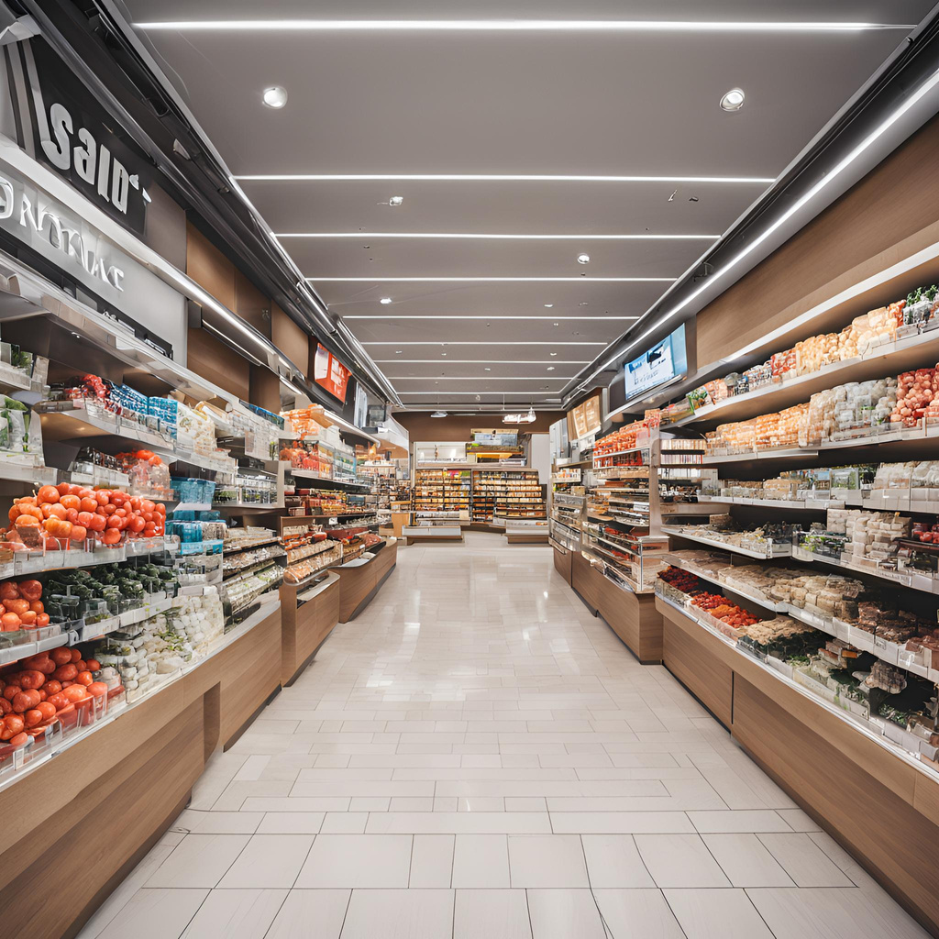
Project Agenda
1 | Problem definition
2 | Hypothesis generation
3 | Data Preprocessing
4 | Data Exploration
5 | Machine learning algorithms
6 | Final overview of project

Slide 3








Introduction

Slide 4

Problem Statement
Prevent overstocking and understocking of Items by forecasting demand of items for the next week, based on historical data.

Slide 5
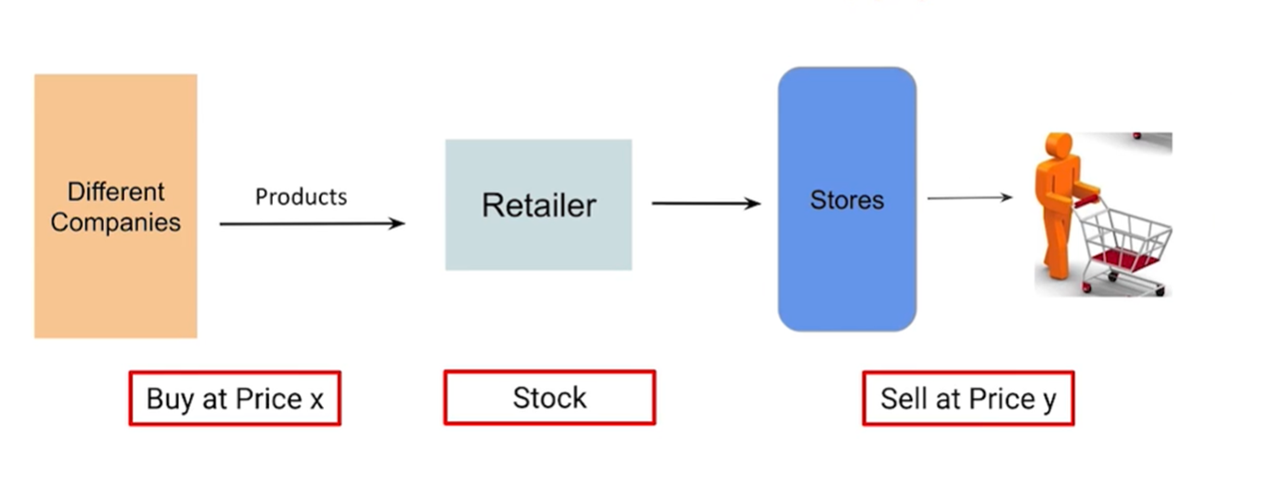
Process of Product Supply
How the product distribute:

Slide 6
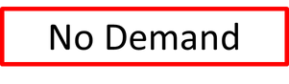
Loss Due to Overstocking

Slide 7
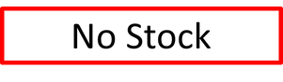
Loss Due to Understocking

Slide 8




Hypothesis Genaration
1
Train Data-
WEEK_END_DATE - week ending date
STORE_NUM - store number
UPC - (Universal Product Code) product specific identifier
BASE_PRICE - base price of item
DISPLAY - product was a part of in-store promotional display
FEATURE - product was in in-store circular
UNITS - units sold (target)

Slide 9
Hypothesis Genaration
2
Product Data-
UPC - (Universal Product Code) product specific identifier
DESCRIPTION - product description
MANUFACTURER - product manufacturer
CATEGORY - category of product
SUB_CATEGORY - sub-category of product
PRODUCT_SIZE - package size or quantity of product

Slide 10
Hypothesis Genaration
3
Store Data-
STORE_ID - store number
STORE_NAME - Name of store
ADDRESS_CITY_NAME - city
ADDRESS_STATE_PROV_CODE - state
MSA_CODE - (Metropolitan Statistical Area) Based on geographic region and population density
SEG_VALUE_NAME - Store Segment Name
PARKING_SPACE_QTY - number of parking spaces in the store parking lot
SALES_AREA_SIZE_NUM - square footage of store
AVG_WEEKLY_BASKETS - average weekly baskets sold in the store

Slide 11

Data Preprocessing

Slide 12

Why Data Preprocessing
Data preprocessing involves transforming raw data into a more suitable format for analysis or modeling.

Slide 13
Data Preprocessing
DATE
Numerical
Categorical
Standardization
Handling Missing
Missing value Imputation
Outlier treatment
Variable Transformation
Missing value Imputation
Sparse Classes or High cardinality
§Convert to Numerical

Slide 14
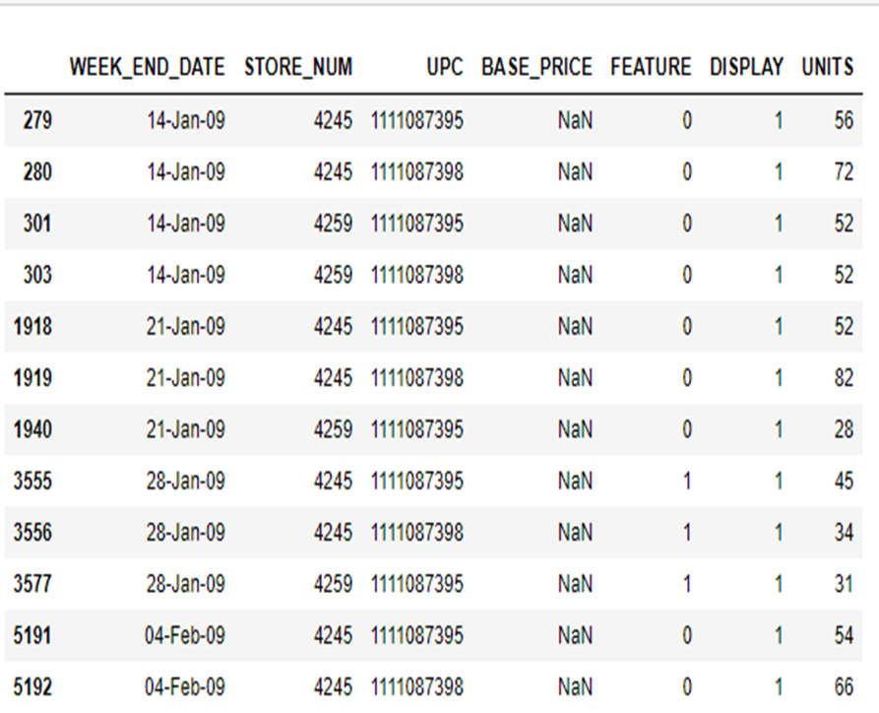

Missing Values
Machine Learning Models can not handle missing values
Impute the missing values with median values.

Slide 15
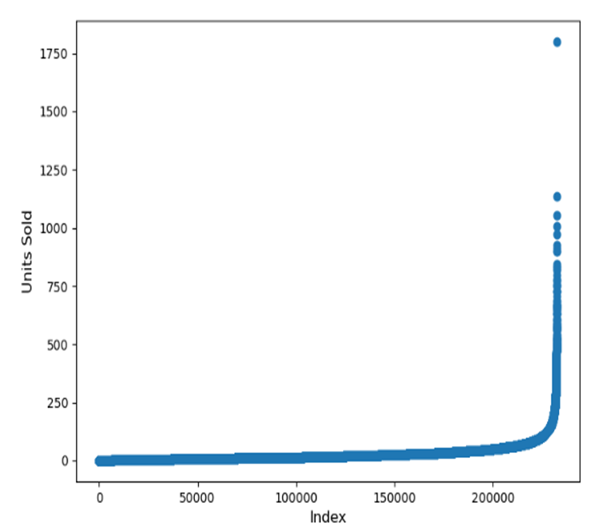
OUTLIERS
•Outliers are extreme values.
•They impact model performance.
•We remove outliers.
•Model performance improves.

Slide 16
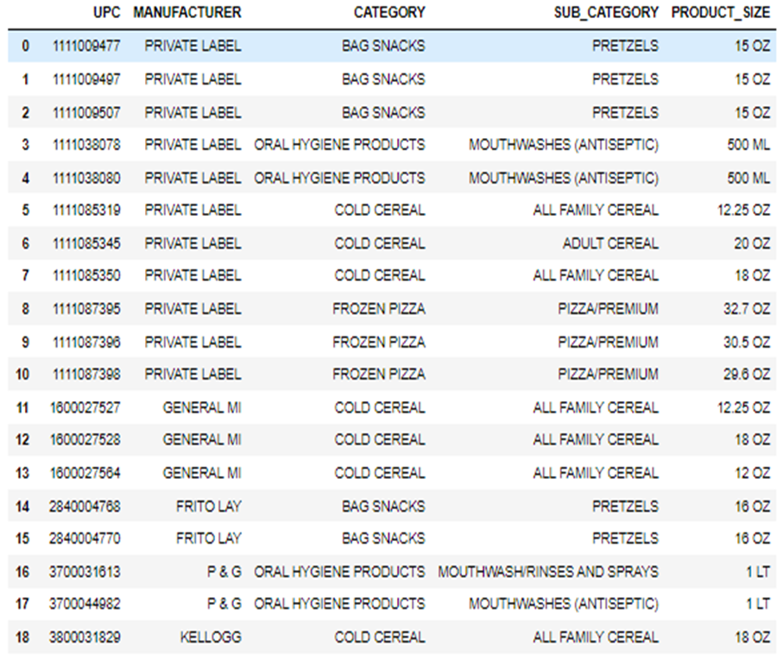
Convert to Numerical
Machine Learning Strings are not supported
Converting strings to numerical values is crucial for enabling machine learning algorithms to process and analyze data effectively.

Slide 17

Data Exploration

Slide 18

Data Exploration
Data exploration is the process of analyzing and understanding the structure, patterns, and characteristics of a dataset to gain insights and inform subsequent analysis decisions.

Slide 19
Dataset Structure
Time Based
Features
Product
Features
Store
Features
When was the
product sold?
which product
was sold?
When was the
product sold?
(232287, 7)
(30, 6)
(76, 9)

Slide 20

Univariate analysis
Univariate analysis is the examination of a single variable to understand its distribution, characteristics, and behavior within a dataset.

Slide 21
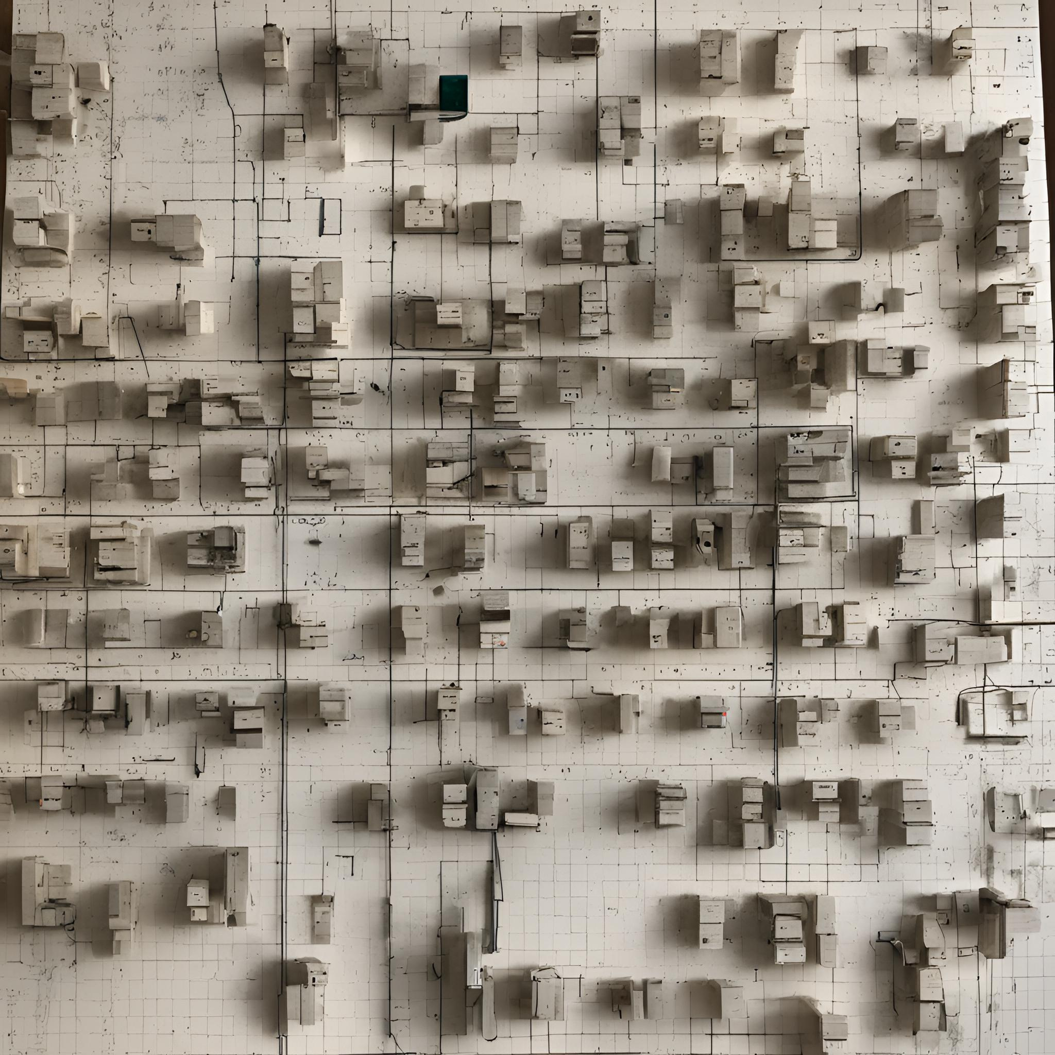
Exploring the
Weekly_Sales_Dataset

Slide 22
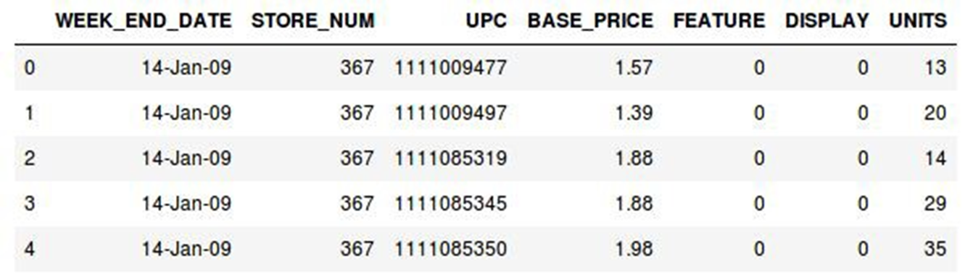
Time Based Feature

Slide 23

WEEK_END_DATE
Data for past 142 weeks - 14 Jan 2009 to 28 Sep 2011
All dates are 7 days apart
No missing dates during this period
Wednesday is the week end date

Slide 24
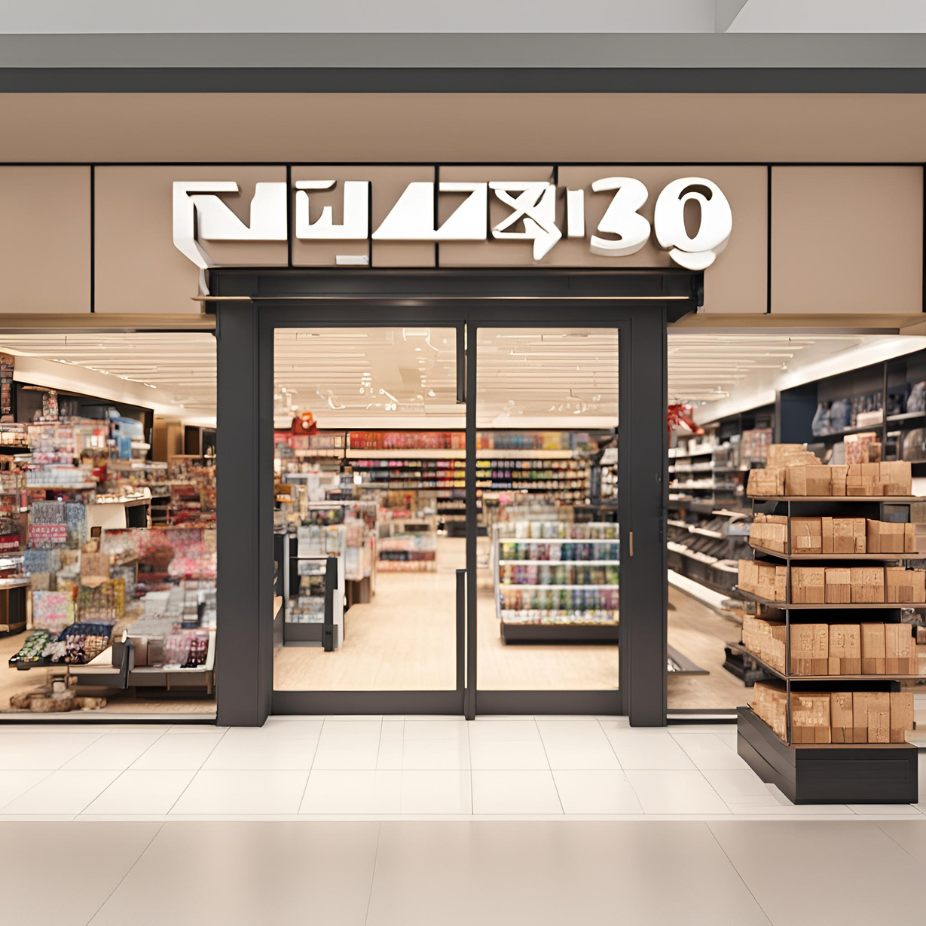
STORE_NUM, UPC
UPC - 30 unique product codes
Each UPC has minimum one unit sold per week
STORE_NUM 76 unique codes
Each store sells minimum of one product perweek

Slide 25
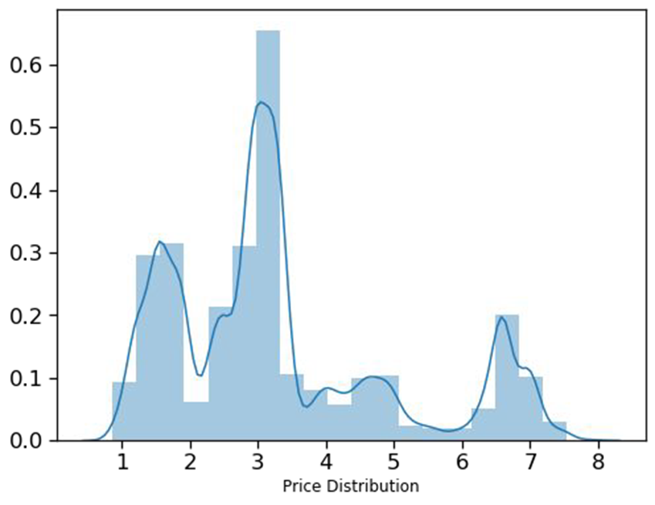
BASE_PRICE
Base_Price Range from 1$ - 8$ for all products
No extreme values

Slide 26
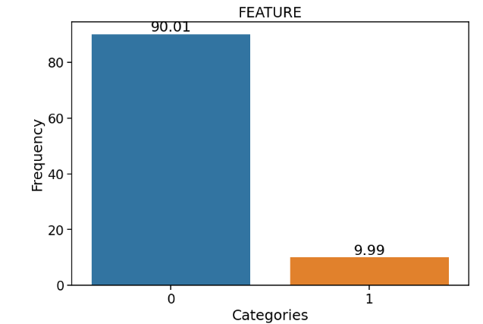
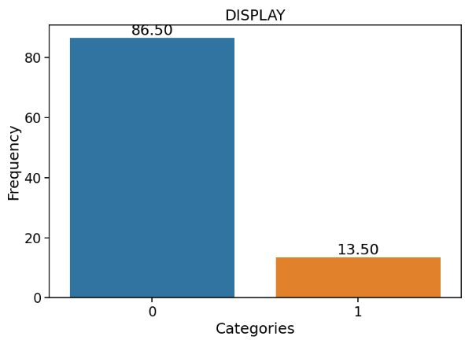
Featured and Display Products
9.99% featured products
13.50% products on display

Slide 27
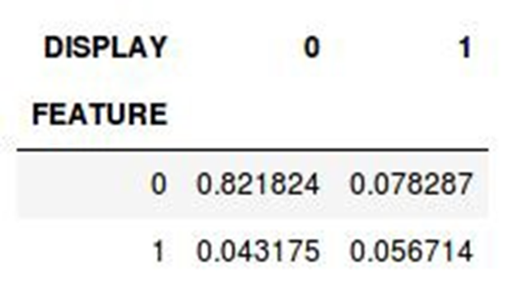
Featured and Display Products
9.99% featured products
13.50% products on display
Only 5% products were on
in-store display and featured

Slide 28
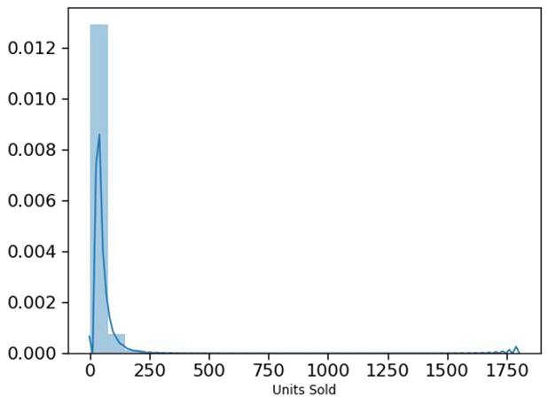
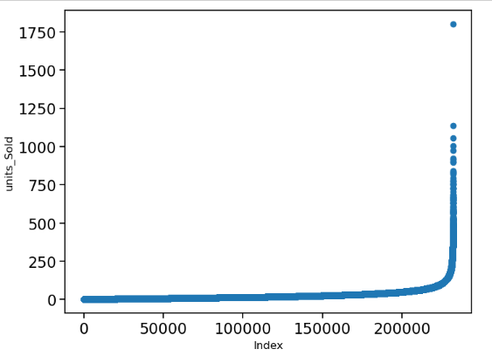
UNITS
Most values lie in range 0 - 250
There are a few outliers

Slide 29
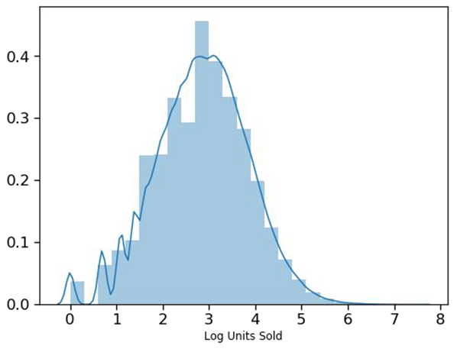
UNITS
•Most values lie in range 0 - 250
•There are a few outliers
•After log transformation, distribution looks closer to a normal distribution

Slide 30

Exploring the
Product_Dataset

Slide 31
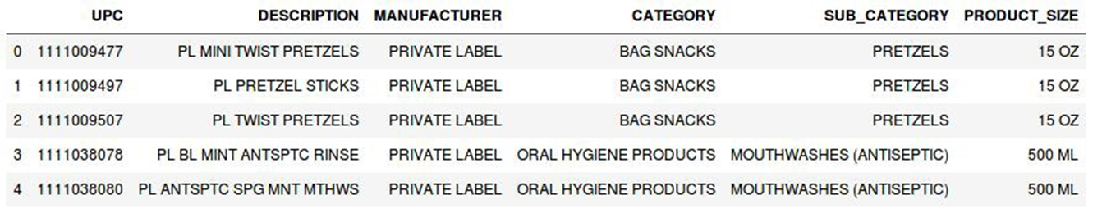
Product_Dataset

Slide 32
UPC
UPC - 30 unique product codes

Slide 33
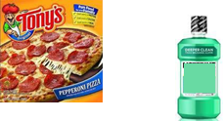
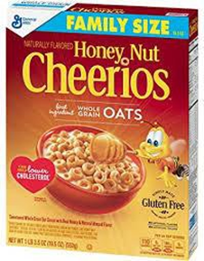
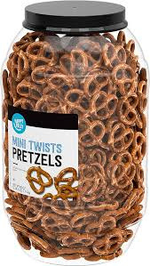
CATEGORY
4 Categories
•Bag Snacks
•Frozen Pizza
•Oral Hygiene
•Cold Cereal

Slide 34
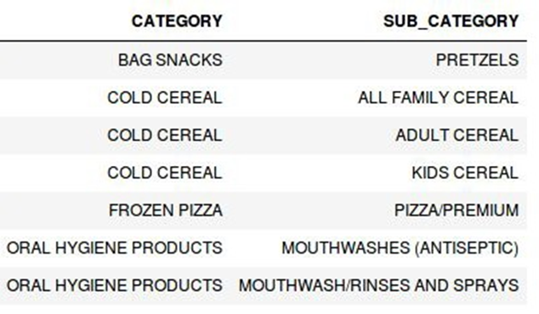
SUB_CATRGORY
7 sub-categories
Bag snacks - 1 subcategory
Frozen pizza - 1 subcategory
Oral hygiene- 2 subcategories
Cold Cereal - 3 subcategories

Slide 35
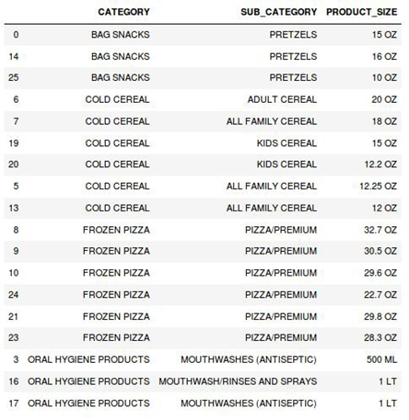
PRODUCT_SIZE
Bag Snacks: Pretzels - Sizes: 10 oz, 15 oz, 16 oz
Cold Cereal: Adult: 20 oz; All Family: 12 oz, 12.25 oz, 18 oz; Kids: 12.2 oz, 15 oz.
Frozen Pizza: 22.7 oz, 28.3 oz, 29.6 oz, 29.8 oz, 30.5 oz, 32.7 oz.
Oral Hygiene Products: Mouthwashes: 1 liter (Antiseptic and Rinses/Sprays)

Slide 36
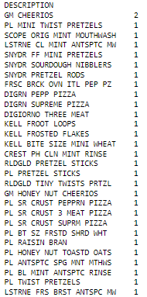
DESCRIPTION
29 distinct descriptions
Provide a more detailed overview of the product.

Slide 37
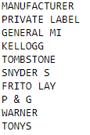
MANUFACTURERS
9 Manufacturers
Private label supplies all 4 category products
Other 8 manufacturers produce only 1 category product

Slide 38
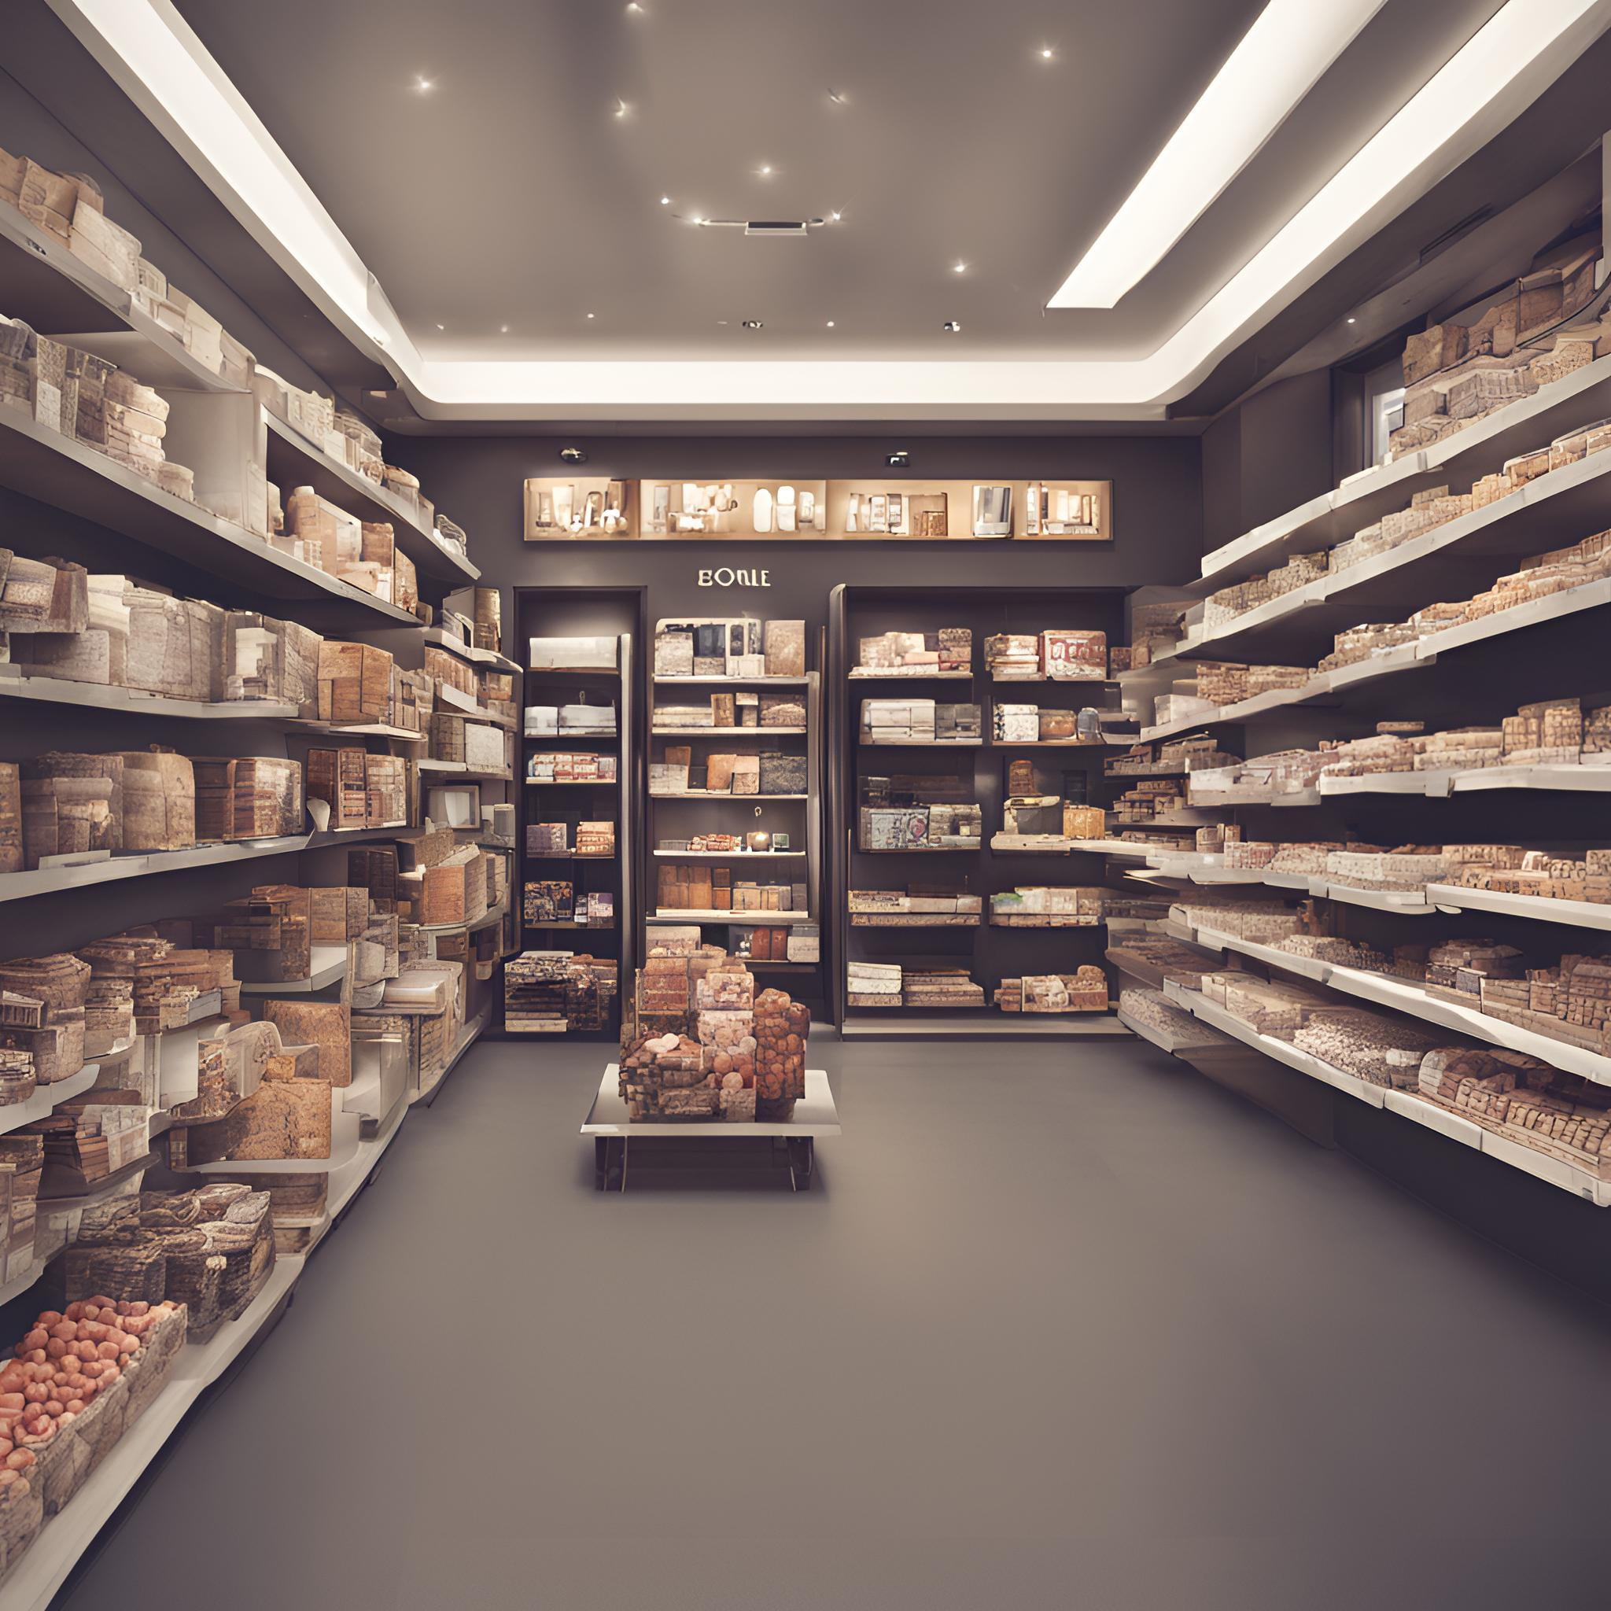
Exploring the
STORE_Dataset

Slide 39
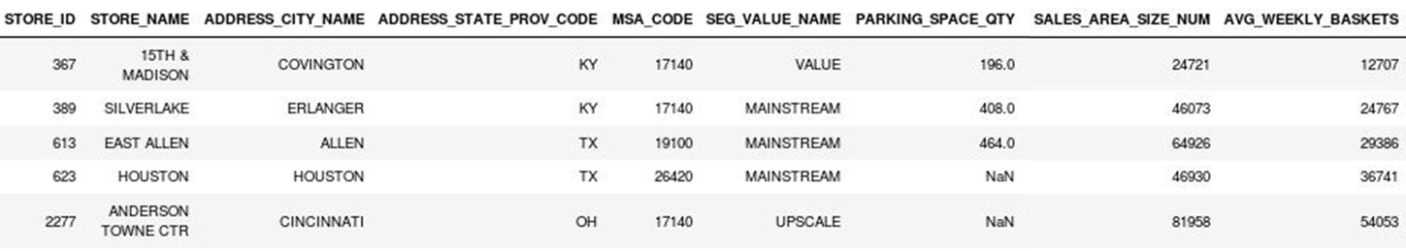
Store_Dataset

Slide 40
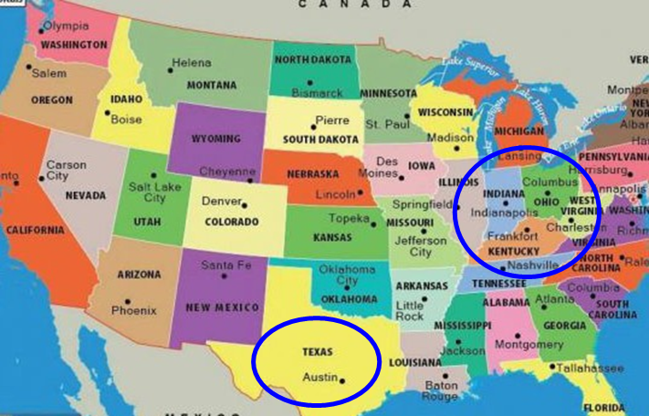
Store Name and Location
76 Store ID
72 Store Names
Located in 51 cities
Spread over 4 States

Slide 41
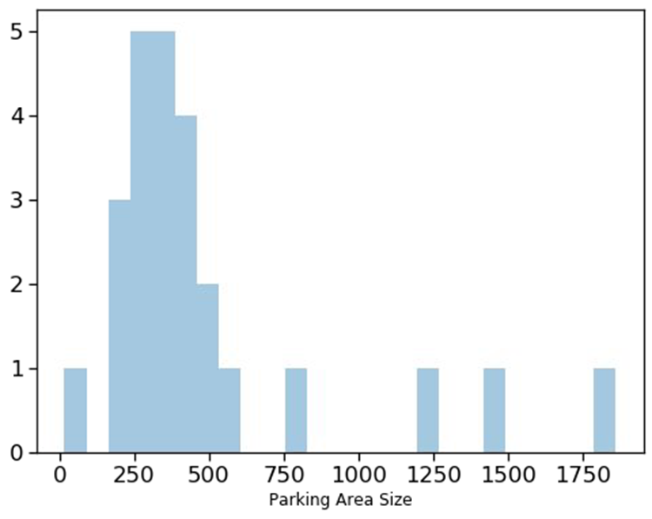
Parking Space Area
Only 25 stores have parking
space area listed
Mostly between 250-500 units

Slide 42
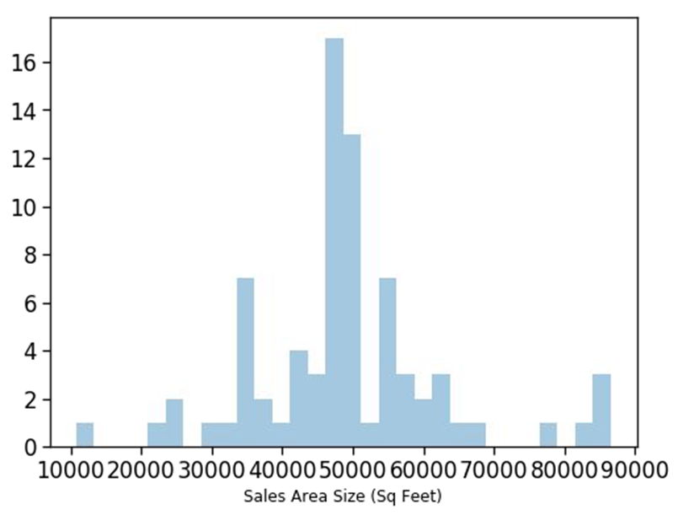
Store Sales Area
Most stores have area 30-70 K
Less than 20 stores with area less than 30k or greater than 90k

Slide 43
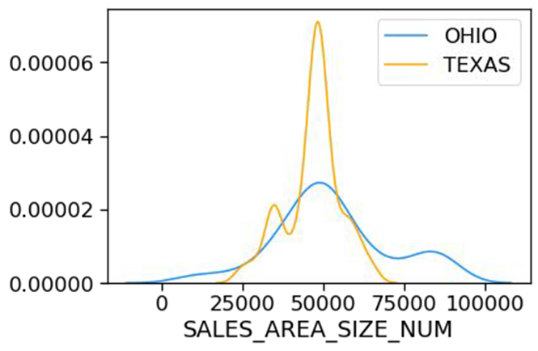
Sales Area for Ohio and Texas
93% of stores are in Ohio and Texas
Ohio has stores with sales area range between 1k-100k
Texas mostly has stores between sales area 30k to 60k

Slide 44
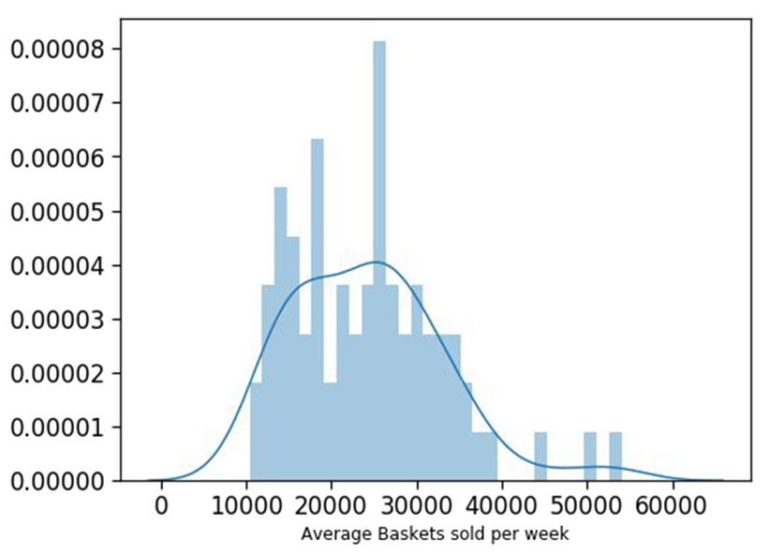
Weekly Average Sale
Weekly average follows rough
normal distribution
Most weeks have average around 25000

Slide 45
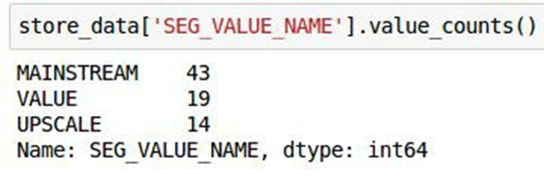
Store Segments
-Upscale stores: Located in high income neighborhoods.
-Mainstream stores: Located in middle class areas, offering a mix of upscale and value product.
-Value stores: Focus on low prices products targeting low in come customers.

Slide 46
Summarizing Data Exploration Insights

Slide 47

Weekly Sales Data
Offer Applicable: Featured Products with attractive offers will have higher sales
Product Promotion: Sales will be more for products with in-store promotion
Hypothesis
Generation

Slide 48
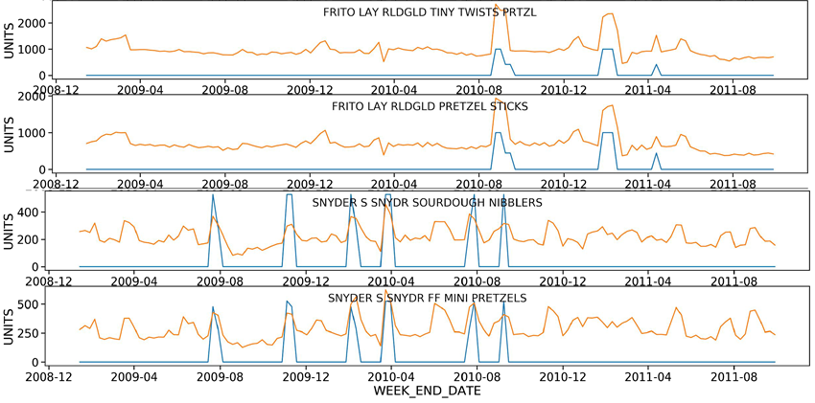
Featured Products
Individual product promotion
have huge impact on sale
Display/featured product have higher sale

Slide 49
●Product Data
Product type/ Category : Different Product Categories can have signiﬁcantly varying trends/patterns
Price of Product: Same category products with lower price have more sales
Product Size : Larger products should be more in demand
Company/ Manufacturer: Well known brands will have higher sales
Hypothesis
Generation

Slide 50
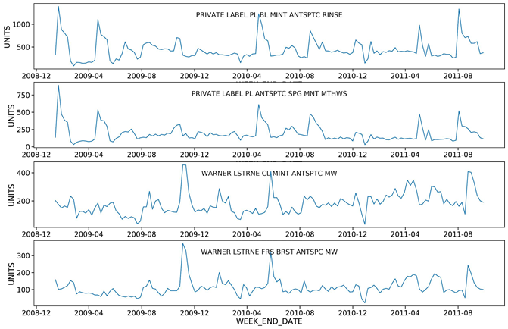
Weekly Average Sale
No signiﬁcant trend or seasonality
overtime
Products by similar manufacturer follow same pattern

Slide 51
●Product Data
Product type/ Category : Different Product Categories can have signiﬁcantly varying trends/patterns
Price of Product: Same category products with lower price have more sales
Product Size : Larger products should be more in demand
Company/ Manufacturer: Well known brands will have higher sales
Hypothesis
Generation

Slide 52
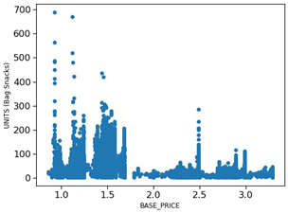
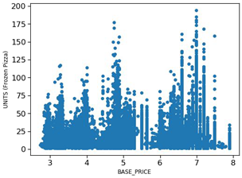
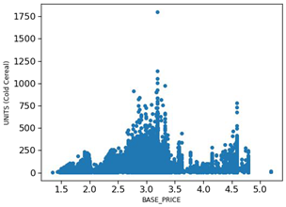
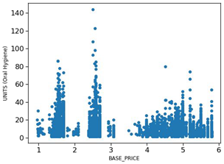
Sales Variation with Base Price
Cold Cereal, Bag snacks and oral hygiene products with lower price have higher sales
Frozen pizza items have higher sale for higher priced pizzas

Slide 53
●Product Data
Product type/ Category: Different Product Categories can have signiﬁcantly varying trends/patterns
Price of Product: Same category products with lower price have more sales
Product Size: Impact of product size on demand
Company/ Manufacturer: Well known brands will have higher sales
Hypothesis
Generation

Slide 54
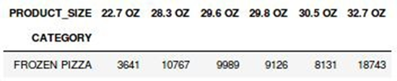
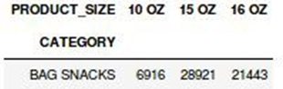
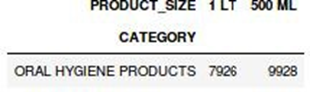
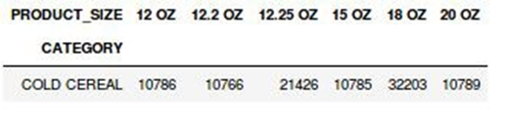
Sales for different Product Size
Increase in Product Size does not show
increase in demand

Slide 55
●Product Data
Product type/ Category : Different Product Categories can have signiﬁcantly varying trends/patterns
Price of Product: Same category products with lower price have more sales
Product Size : Larger products should be more in demand
Company/ Manufacturer: Well known brands will have higher sales
Hypothesis
Generation

Slide 56
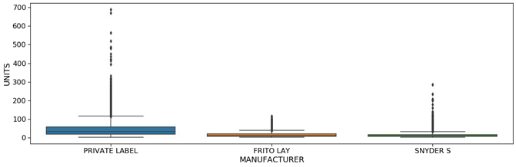
Sales for Different Manufacturers

Slide 57

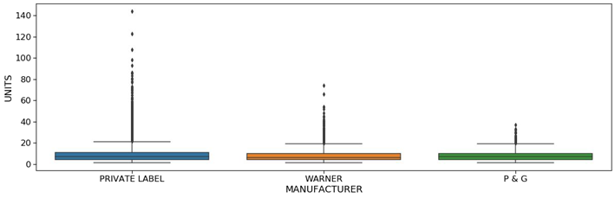
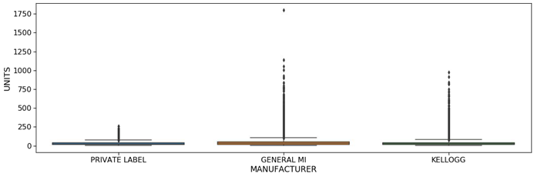
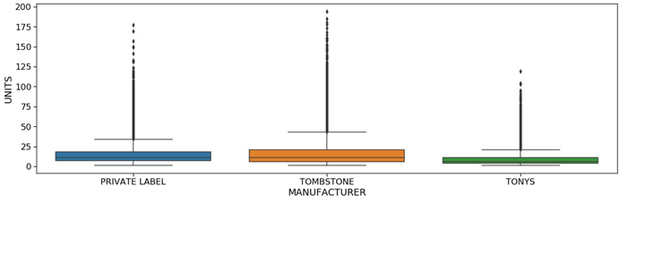
Sales for Different Manufacturers
BagSnacks
Oral Hygiene
ColdCereal
FrozenPizza

Slide 58
●Store Data:
Store Location: Stores in a particular state/city will have a similar trend
Size of Store: Stores with larger area would have more sales
Average Wait time: Lower wait time, higher units sold.
Hypothesis
Generation

Slide 59
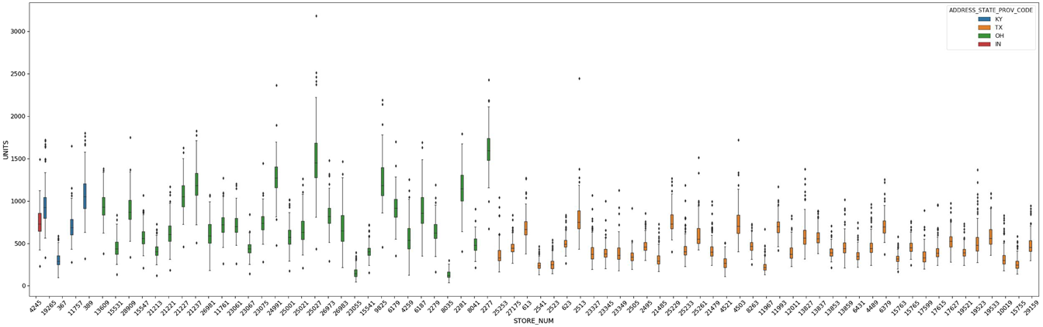
Store-wise unit sales for States

Slide 60
●Store Data:
Store Location: Stores in a particular state/city will have a similar trend
Size of Store: Stores with larger area would have more sales
Average Wait time: Lower wait time, higher units sold.
Hypothesis
Generation

Slide 61
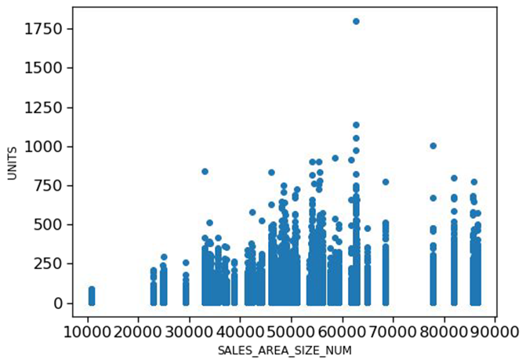
Unit Sale variation with Store Size
Average Size stores have highest sales
Small Sized stores have very low sale

Slide 62
●Train Data:
DISPLAY: product was a part of in-store promotional display
FEATURE: product was in in-store circular
Hypothesis
Generation

Slide 63

Display vs. Feature: Impact on Consumer Demand
Display has more impact on demand than Feature.

Slide 64
Product data
Impact of Manufacturer Diversity on Category and Subcategory Demand
CATEGORY: category of product
SUB_CATEGORY: sub-category of product
Hypothesis
Generation

Slide 65

Manufacturer Diversity and Demand Impact
Private Label products dominate demand, with significantly higher units sold compared to other manufacturers.
General Mills and Kellogg also show strong demand, whereas P&G, Tony's, and Warner have minimal sales.

Slide 66
Train data
Relationship between Price Discount and Units Sold
BASE_PRICE: base price of item
UNITS: units sold (target)
Hypothesis
Generation

Slide 67

Relationship between Price Discount and Units Sold
when items are sold at a lower price than usual, more of them are bought.

Slide 68

Evaluation metrics

Slide 69
Data Gathering
Machine learning pipeline
Data Exploration
Data preprocessing

Slide 70

Machine learning pipeline

Slide 71

Machine learning pipeline

Slide 72

Problem Statement
Forecast the demand of packed items for each store in the next week to reduce overstocking and understocking

Slide 73
Evaluation metrics for Regression
Mean Absolute Error
Root Mean Squared Error
Root Mean Squared Log Error

Slide 74

Problem Statement
Predict the demand of packed items for each store to reduce overstocking and understocking

Slide 75

Model Evaluation

Slide 76

Model Evaluation

Slide 77

Mean Absolute Error

Slide 78

Mean Squared Error

Slide 79
Root Mean Squared Error

Slide 80


Evaluation Metric

Slide 81

Root Mean Log Square Error

Slide 82

Results and Report

Slide 83
Problem Statement
Predict the demand of packed items for each store to reduce overstocking and understocking

Slide 84

Available datasets

Slide 85

Machine learning models

Slide 86
Machine learning models

Slide 87

Most Important Features- Random Forest

Slide 88

Most Important Features- XGBoost

Slide 89

Most Important Feature- Cat boost

Slide 90
Top Four Features
 | Model -1(Random Forest) | Model-2(XGBoost) | Model-3(CatBoost)
Feature 1 | Average units in 2 months | Feature | Feature
Feature 2 | Feature | Average units in 2 months | Average units in 2 months
Feature 3 | Lag Feature -52 weeks | Manfacturer-2 | Lag Feature -52 weeks
Feature 4 | Base Price | Display | Display

Slide 91

Final Pipeline

Slide 92

Final Pipeline

Slide 93

Final Pipeline

Slide 94



Thank you
M.RAMA GOPALA KRISHNA

